Slide 1
Pre-Session Survey
[include QR code and link]
Notes:
We conducted a survey before and after strategic planning (SP) sessions. The pre-survey can be distributed one week in advance via email and we recommend sharing a QR code/link at the beginning of the session as a prompt to those who did not already fill it out. These data are used for program improvement processes and session attendees are asked to contribute in their professional capacity.

Slide 2
Countering harmful and misleading public health rumors
Region 3 PHPR Center Strategic Planning Session
Presenters: [Name(s)]
[Date]

Slide 3
Disclaimer and Use Guidance
You can present these slides during rumor management strategic planning sessions. Slides include didactic content, interactive discussion prompts, and relevant presentation details in the speaker notes section. Some slides are optional or alternatives. The following materials are distributed during sessions and complement this deck:
An evaluation survey before and after each session
A ‘cheat sheet’ implementation guide distilling key didactic learnings
A worksheet participants can use to create their own rumor management action plan, either during or after sessions
Please tailor these slides to your setting and needs for better uptake.

Slide 4
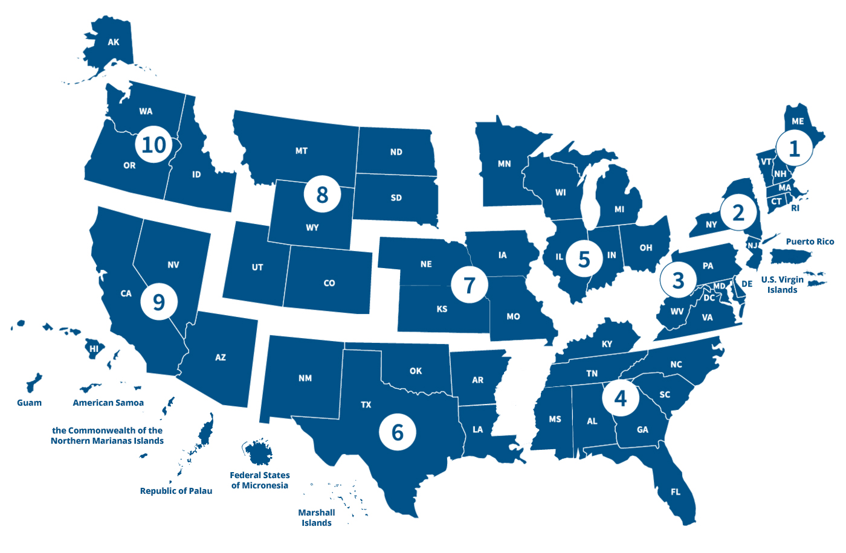
CDC Region 3 PHPR Center
Notes:
The Johns Hopkins Center for Health Security (CHS) and the Johns Hopkins Office of Critical Event Preparedness and Response (CEPAR) lead the Regional Center for Public Health Preparedness and Response (PHPR) for the US Department of Health and Human Services (HHS) Region 3, which includes Delaware, the District of Columbia, Maryland, Pennsylvania, Virginia, and West Virginia. This work is part of a national initiative to enhance public health preparedness and response (PHPR) capabilities across the United States. The 10 Regional Centers will form a network to enhance communities’ ability to prepare for and respond to public health threats by advancing the uptake of evidence-based strategies and interventions.
The Region 3 PHPR Center will organize its work using a framework developed through a collaborative effort with regional stakeholders and will focus on 1) Communication and Community Engagement; 2) Coordination Across Agencies, Community Organizations, and Systems; and 3) Workforce Recruitment, Retention, and Competencies Growth. Outcomes from this work will result in building agency capabilities and/or growing community resilience, and work will occur across all hazards.
This rumor management strategic planning session is an evidence-based strategy and/or intervention being implemented as part of the Center’s Communication & Community Engagement pillar. For more information, visit: https://centerforhealthsecurity.org/our-work/preparedness-initiatives/phpr

Slide 5
Timeline and tasks associated with the rumor management intervention
NOW
OVER THE NEXT 3 MONTHS
3 MONTHS LATER
Strategic planning session
Finalize strategic plan
Implement strategic plan
Measure progress on strategic plan
Endline evaluation
Baseline evaluation
Finish implementing strategic plan
Notes:
This graphic explains the timeline and tasks associated with the rumor management intervention.

Slide 6
Session Goals
Understand ways to counter misleading & harmful public health rumors that undermine your efforts to prepare for and respond to public health emergencies
Develop a strategy for countering these rumors
Empower you to implement your strategy in your teams
Improve public health emergency preparedness and response in our region

Slide 7
Agenda
Introductions
Pre session survey
Overview of playbook
Setting yourself up for success
Deciding whether to address misleading rumors
Choosing how to address misleading rumors
Evaluating your efforts
Creating a strategic plan
Post session survey
Activity 1
Activity 2-6
Activity 7
Notes:
Blue boxes denote didactic components where a trainer/presenter is speaking. Orange boxes denote interactive portions where participants discuss and contribute. Grey boxes denote data collection. Work done as part of each activity will feed into the strategic planning worksheet participants complete as the session proceeds.

Slide 8

Share introductions
Notes:
This is where presenters introduce themselves and ask participants to share introductions.
IN PERSON
Option 1: If <15 people in a room, introduce yourself and then each person to share: 1) their name, 2) their position, 3) what they work on, 4) what motivated them to attend this training and what they want to get out of it, and 5) what is the weirdest rumor they have ever come across in their work? #4 can be cut for sake of time.
Option 2: If >15 people in a room, introduce yourself and then ask volunteers to raise their hand and share: 1) their department/ role, 2) the weirdest rumor they have come across at work, and 3) why they are in the room. #3 can be cut for sake of time.
VIRTUAL
Option 1: If <15 people, ask participants to unmute and share their name, position, and what they work on.
Option 2: If >15 people, ask participants to introduce themselves via chat.

Slide 9
Misleading health rumors and information manipulation
Reduce trust in public health authorities
Hinder public health preparedness and response
Influence health behavior
Impact health outcomes
Notes:
This slide discusses the main impacts of rumors on public health preparedness and response. Rumors – or circulation of unverified claims – are a way to make sense of the world during uncertain situations; however, harmful and misleading health rumors can have several negative impacts.

Slide 10
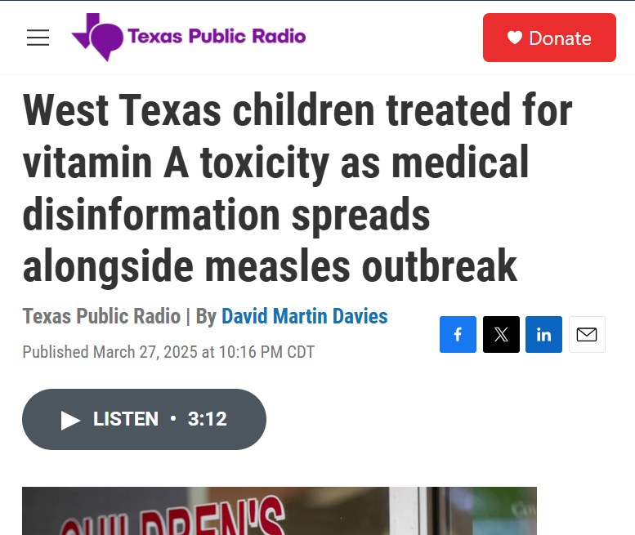
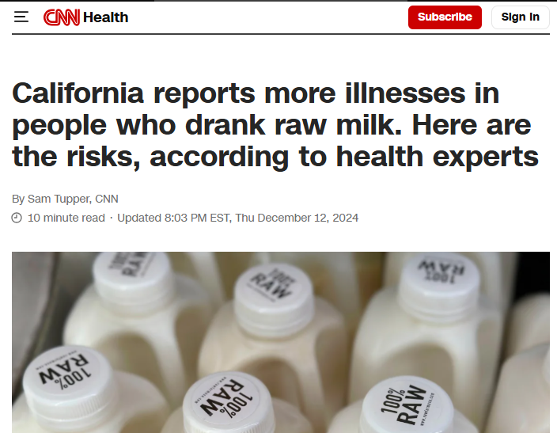
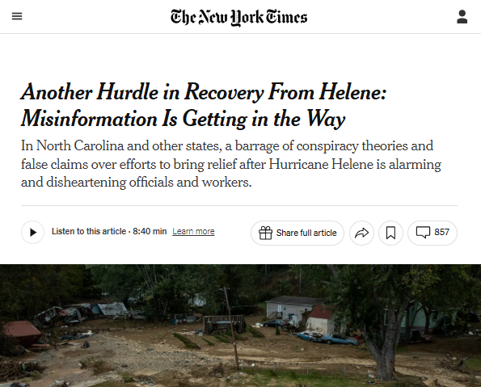
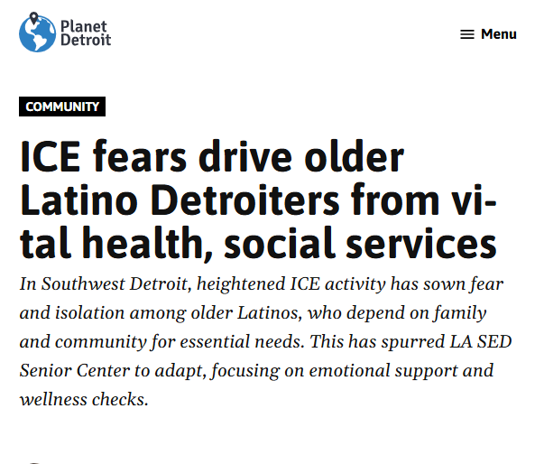
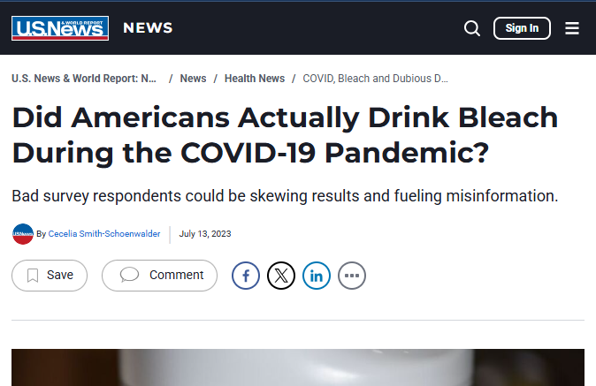
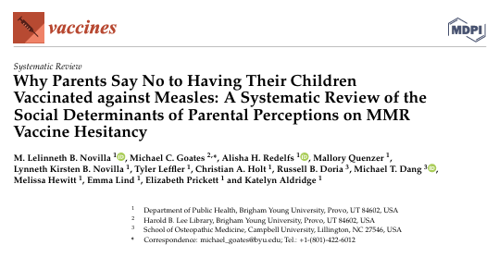
Examples showing misleading and harmful headlines
Notes:
This slide presents recent examples of headlines showing how misleading and harmful rumors tangibly impact public health emergency preparedness and response. Replace images with headlines more relevant to your audience and time period.

Slide 11
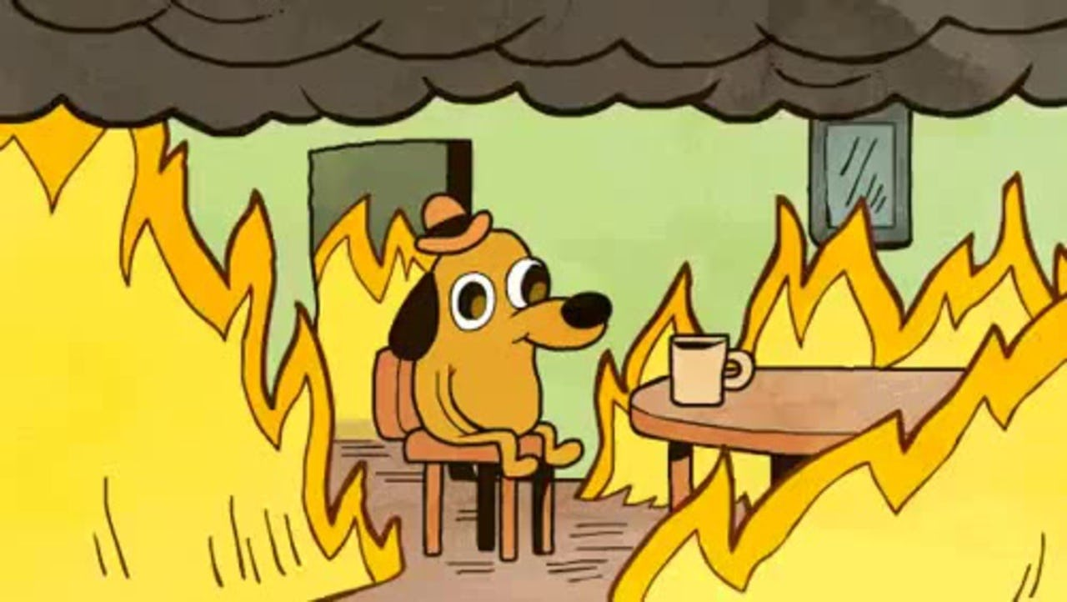
Misinforamtion feels chaotic
Notes:
This slide is used to denote how in practice, dealing with misinformation feels a lot like this: chaotic, there’s always another fire to put out, overwhelming.

Slide 12
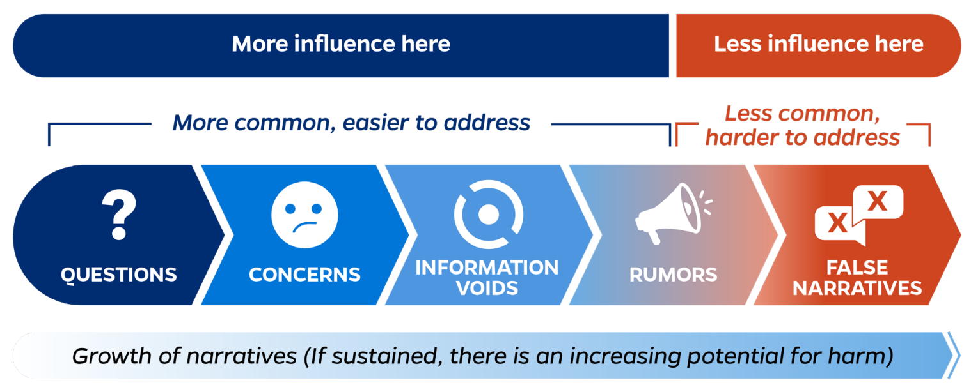
Unit for High Impact Events Preparedness and Prevention
Adapted from WHO Infodemic Management, Unit for High Impact Events Preparedness and Prevention
Notes:
Emphasize the importance of answering people’s questions and concerns before information voids are filled with false claims that fester into mis- and disinformation. Questions and concerns are more common, especially during the onset of an emergency, and are easier to address. False narratives are more difficult to ‘unstick’ from people’s minds.

Slide 13
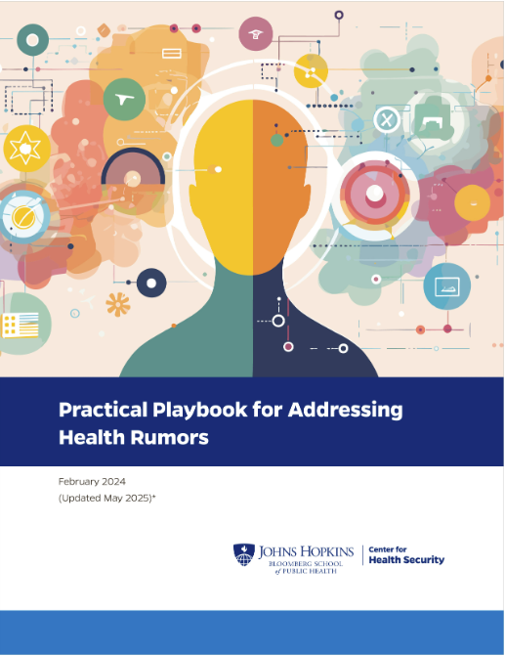
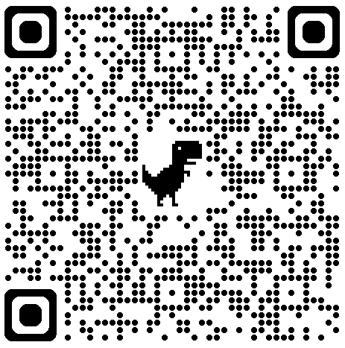
FOLLOW ALONG:
Notes:
Participants can follow the content of this presentation by having the Practical Playbook for Addressing Health Rumors open on their computers: https://centerforhealthsecurity.org/our-work/research-projects/trust-in-public-health/tackling-rumors/trust-playbook
Strategic planning sessions pull heavily from the Playbook’s content and use it as a capacity-building tool for strategically managing rumors.

Slide 14
The Playbook provides guidance on ways public health and medical professionals can:
Prepare for health-related rumors
Decide when to act to address misleading rumors
Determine which actions to take to address misleading rumors
Develop messages to address misleading rumors
Gather feedback on messages

Slide 15
Set yourself up for success before rumors spread
Identify ‘prework’ or things you can do before rumors arise
Put together a team for when you need to address a rumor
Connect with communities and build partnerships
Get to know your audience
Set up a way to
identify rumors
Answer audience questions and concerns quickly
Notes:
If there is time: pause at the end and ask the group: which of these do you already practice? Refer to the Practical Playbook for Addressing Health Rumors for more information on this section.

Slide 16
Set up a way to identify misinformation
Social listening is a form of information tracking used to identify false claims or information gaps within a community. It is a foundational tool of infodemic management and allows health communicators to better address people’s information needs by filling information gaps, answering relevant questions, and managing misleading information.
Ask community partners
Monitor comment sections of social media and built-in analytics
Identify sources and individuals spreading rumors
Monitor trending hashtags
Use internal tools like call center questions
Use free tools like Google Alerts and Talkwalker
Notes:
OPTIONAL SLIDE to delve further into information tracking and social listening. Refer to the Practical Playbook for Addressing Health Rumors for more information on this section.

Slide 17
Decide whether to address the rumor
STEP 1
Identify your goal for responding to a rumor
Identify what influences your decision to respond
Decide whether you will address the rumor
What is the intended outcome of your message?
How serious is
the rumor?
What minimum conditions do you need to act?
What are your larger goals and specific objectives?
What is your capacity
to act?
Which conditions immediately trigger action?
Are your goals SMART and tailored to audiences?
How will you account for negative consequences?
Which conditions prevent you from acting?
Notes:
Refer to the Practical Playbook for Addressing Health Rumors for more information on this section. If you are pressed for time, this section can be skipped without impacting the rest of the session significantly.

Slide 18

ACTIVITY 1
STRATEGIC PLAN Q1
Which factors do you consider when deciding whether to counter a public health rumor?
What influences your decision to respond?
How do you balance different decision-making factors?
Notes:
Questions in orange are meant to guide people’s thinking.
If people are there in distinct teams, ask them to sit with their teams and work as a group for the rest of the session.
If people are not there in distinct teams, ask people to get into groups of 3-4 people.
If you are only training 1 team or <10 people, the whole group can work on this as one.
If you are pressed for time, this activity can be skipped without impacting the rest of the session significantly.

Slide 19

You’ve detected a rumor and have decided to address it
Notes:
At this point, we will move forward as if participants have detected a rumor and have decided to address it.

Slide 20
Take action to address rumors
STEP 2
Identify the type of rumor that is spreading
Choose an action approach
Choose strategic ways to frame your message
Characterize your priority audience and your communication goals for them
Select communications channels and trusted messengers
Create and disseminate your message using good practices
Notes:
This slide outlines the main steps when taking action to address rumors.

Slide 21
Take action to address rumors
STEP 2
Identify the type of rumor that is spreading
Safety of approved, authorized, or unapproved interventions
Efficacy of approved, authorized, or unapproved interventions
Changing guidance
Risk or severity of a health condition
Cause of a health condition
Trustworthiness of health agency or organization
Trustworthiness of implementers
How people understand the world around them
Blaming or stigmatizing a population as the cause or spreader of a health condition
Confusion around previous messaging
Desire for certainty when the situation is uncertain
Notes:
This slide highlights types of rumors that we see repeatedly during public health emergencies. Briefly highlight 1-2 examples when presenting.

Slide 22
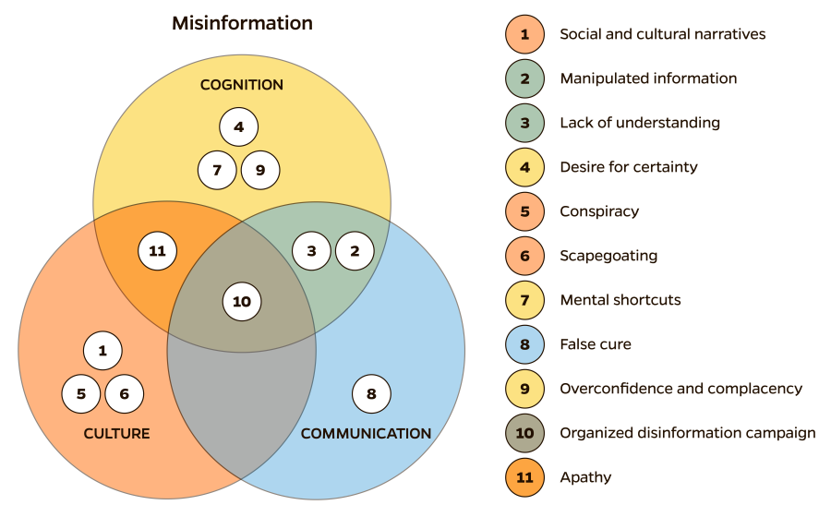
Take action to address rumors
STEP 2
Identify the type of rumor that is spreading
Notes:
Identifying recurring rumors can help us prepare for when they reemerge during the next public health emergency. The Johns Hopkins Center for Health Security collected rumors that circulated during several past public health emergencies and identified common thematic categories, shown here. Note that rumors can be rooted in strongly held beliefs and other sociocultural narratives that are deeply rooted and difficult to change (culture); how people think and process information on an individual level (cognition); and issues in how we communicate with each other. This matters because not all methods for countering rumors are effective across all categories. For example, sharing accurate information to fill information voids may not effectively ‘unstick’ rumors rooted in conspiracy theories and strongly held beliefs/ sociocultural narratives.

Slide 23
Take action to address rumors
STEP 2
Identify the type of rumor that is spreading
Understand
the type of rumor that
is circulating
Deconstruct it to show what the rumor
aims to do
Identify what information, if shared with people, would resolve the rumor
Identify the level of
risk the rumor poses to people’s health
and wellbeing*
* high-risk rumor may need a more proactive response, such as prebunking or inoculation
Notes:
OPTIONAL SLIDE to delve further into the significance of identifying the type of rumor that is spreading.

Slide 24
ACTIVITY 2
STRATEGIC PLAN Q2-4
What is 1 harmful public health rumor you’ve observed recently that makes it difficult for you to prepare for or respond to an emergency?
In what context are you seeing this rumor?
Why do you think people believe the rumor?
What impact might the rumor have on people?
What makes the rumor harmful?
How does the rumor undermine PHEPR?
Notes:
Questions in orange are meant to guide people’s thinking. Noting level of risk is helpful, because if a rumor has high risk, participants should prioritize prebunking and other anticipatory action.
If people are there in distinct teams, ask them to sit with their teams and work as a group for the rest of the session.
If people are not there in distinct teams, ask people to get into groups of 4-6 people.
If you are only training 1 team or <10 people, the whole group can work on this as one.
Teams must select a rumor, as it is the basis of all remaining activities. If all participants are working together as one group, ask them to volunteer some rumors; if they cannot agree on one rumor (or general topic/type of rumor), then select one that is the most broadly applicable. Encourage participants to identify a rumor that actually shows up in or affects their work, instead of something that they may have generally heard about.

Slide 25
Rumors
RUMOR
RUMOR
RUMOR
RUMOR
RUMOR
RUMOR
RUMOR
RUMOR
RUMOR
RUMOR
RUMOR
RUMOR
RUMOR
RUMOR
Notes:
Populate this slide with rumors relevant to participants area/work, to use in case they cannot identify a rumor that undermines PHEPR.

Slide 26
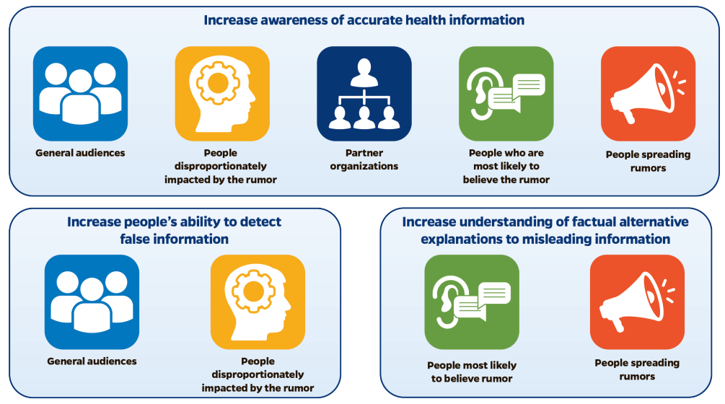
Take action to address rumors
STEP 2
Characterize your priority audience and your communication goals for them
Notes:
Refer to the Practical Playbook for Addressing Health Rumors for more information on this section.

Slide 27
ACTIVITY 3
STRATEGIC PLAN Q5-6
Which audiences would you prioritize when countering the rumor you have selected?
Who is spreading the rumor?
Does the rumor disproportionately affect any populations?
Are some people more vulnerable to believing this rumor?
Are you/ partner organizations considered trusted messengers for people spreading the rumor?
What are your communication goals for your priority audience(s)?
Is it increasing awareness of accurate information?
Increasing people’s ability to detect false information?
Increasing understanding of factual alternative explanations to misleading information?
Something else?
Notes:
If there is a disproportionately affected/likely to believe population, prioritize them before others, but if neither are affected or effect is unclear, prioritize other groups.
If partners are helpful or you’re a trusted messenger, prioritize general audiences and partner organizations, then people who are spreading the rumor. Otherwise, just prioritize general populations.
If you work with trusted partners, co-create messages with them.
If not, focus on people who are likely to believe and be most impacted by the rumor, as well as general audiences.

Slide 28
Take action to address rumors
STEP 2
Choose an action approach
Amplify accurate information
Fill information voids
Leverage trusted messengers and engage communities
Refute, fact-check, or debunk
Prebunk and inoculate
Improve health and
science literacy
Notes:
Although there are numerous approaches practitioners can use to manage rumors, these six are reliable options for resource- and time-constrained practitioners to consider. The top row shows less resource-intense options and the bottom row shows more resource-intense ones, as one often needs to determine e veracity of claims in order to prebunk or debunk. Refer to the Practical Playbook for Addressing Health Rumors for more information on this section.

Slide 29
Take action to address rumors
STEP 2
Choose an action approach
COMMUNICATION GOAL
POTENTIAL ACTION APPROACH
Increase awareness of accurate health information
AND
Increase people’s ability to detect false information
Amplify accurate information.
Share accessible, accurate, tailored, and culturally appropriate information from first-hand or other trusted sources, or point people to credible sources of information. Exposing individuals to factual information may make it easier for them to resist false information when they come across it.
Notes:
Practitioners can select an action approach based on their communication goal. Refer to the Practical Playbook for Addressing Health Rumors for more information on this section.

Slide 30
Take action to address rumors
STEP 2
Choose an action approach: amplify accurate information
DO | DON’T
Use messages that strongly appeal to morals and emotions like disgust and compassion, but not panic. Improve audiences’ ability to judge the credibility of sources sharing information related to a rumor, such as by assessing the reputation of a source, whether the author is qualified to discuss the issue, how accurate the information is, etc. Empower audiences to amplify factual information in their circles. | Worry that reframing messages may negatively impact people outside your target audience. Evidence suggests this is unlikely. Ignore possible problems, such as others twisting your messages or public officials or influencers discrediting you to further their own agendas.
Notes:
OPTIONAL SLIDE on Do’s and Don’ts for this action. Refer to the Practical Playbook for Addressing Health Rumors for more information on this section.

Slide 31
Take action to address rumors
STEP 2
Choose an action approach
COMMUNICATION GOAL
POTENTIAL ACTION APPROACH
Increase awareness of accurate health information
Fill information voids
Quickly provide credible, accessible, and correct information to answer common questions or fill knowledge gaps
Leverage trusted messengers and engage communities
Use spokespersons who are trusted by your priority audiences to convey key messages and encourage community participation in health communication. Leveraging trusted messengers can be a low-cost way to build trust
Notes:
Practitioners can select an action approach based on their communication goal. Refer to the Practical Playbook for Addressing Health Rumors for more information on this section. Use this slide if you are not delving into Do’s and Don'ts of each action.

Slide 32
Take action to address rumors
STEP 2
Choose an action approach
COMMUNICATION GOAL
POTENTIAL ACTION APPROACH
Increase awareness of accurate health information
Fill information voids
Quickly provide credible, accessible, and correct information to answer common questions or fill knowledge gaps
Notes:
Practitioners can select an action approach based on their communication goal. Refer to the Practical Playbook for Addressing Health Rumors for more information on this section. Use this slide if you are delving into the Do’s and Don’ts of each action.

Slide 33
Take action to address rumors
STEP 2
Choose an action approach: fill information voids
DO | DON’T
Act quickly before other actors can fill the void with misinformation. Adapt content into different languages. Be sure to maintain the original tone, intent, and style. Use simple language and graphics. | Wait to act. It’s okay to fill information gaps even as scientific evidence is still evolving. Create generic content that is not tailored to diverse audience needs and beliefs. Assume that translating materials into other languages is enough to reach diverse audiences. Assume that telling people about their individual risk of disease will influence their actions. Overemphasizing individual risk may actually increase a person’s unrealistic optimism in not getting or transmitting a disease, particularly as a coping mechanism.
Notes:
OPTIONAL SLIDE on Do’s and Don’ts for this action. Refer to the Practical Playbook for Addressing Health Rumors for more information on this section.

Slide 34
Take action to address rumors
STEP 2
Choose an action approach
COMMUNICATION GOAL
POTENTIAL ACTION APPROACH
Increase awareness of accurate health information
Leverage trusted messengers and engage communities
Use spokespersons who are trusted by your priority audiences to convey key messages and encourage community participation in health communication. Leveraging trusted messengers can be a low-cost way to build trust
Notes:
Practitioners can select an action approach based on their communication goal. Refer to the Practical Playbook for Addressing Health Rumors for more information on this section. Use this slide if you are delving into the Do’s and Don’ts of each action.

Slide 35
Take action to address rumors
STEP 2
Choose an action approach: engage trusted messengers & communities
DO | DON’T
Collaborate with communities to develop culturally appropriate messaging. Empower trusted messengers from the community to disseminate accurate information and reject false information. Use an in-group spokesperson to better connect with your intended audience. Reframe messages to align with the audience’s most important values. | Overburden resource-limited community organizations with more unpaid work. Reinforce harmful social norms.
Notes:
OPTIONAL SLIDE on Do’s and Don’ts for this action. Refer to the Practical Playbook for Addressing Health Rumors for more information on this section.

Slide 36
Take action to address rumors
STEP 2
Choose an action approach
COMMUNICATION GOAL
ACTION APPROACH
Provide factual alternative explanations
Refute, fact-check, or debunk
Refute false claims by highlighting factual errors (fact-based debunking), providing other explanations, identifying flawed reasoning or logical fallacies (logic-based debunking), and/or by calling into question the credibility of the source of false information (source-based debunking).
Note: Simply stating that a rumor is incorrect/ questionable/ coming from an untrustworthy source is unlikely to dispel rumors. Alternatives should be robust but not too complex and must maintain the same explanatory appropriateness as the original misinformation.
Notes:
Practitioners can select an action approach based on their communication goal. Refer to the Practical Playbook for Addressing Health Rumors for more information on this section.

Slide 37
Take action to address rumors
STEP 2
Choose an action approach
COMMUNICATION GOAL
ACTION APPROACH
Increase people’s ability to detect false information
Prebunk and inoculate
Preemptively refute anticipated false information or manipulation tactics before people are exposed to a rumor, which protects them from believing in the rumor when it comes up eg, by educating people about common tactics of deception or manipulation and encouraging more critical thinking.
Notes:
Practitioners can select an action approach based on their communication goal. Refer to the Practical Playbook for Addressing Health Rumors for more information on this section.

Slide 38
Take action to address rumors
STEP 2
Choose an action approach: refute, fact-check, debunk, prebunk, or inoculate
DO | DON’T
Provide enough detail. Offer factual alternative explanations when correcting false information. Warn readers that you’re going to repeat false claims in order to debunk the rumor. Repeat the guidance you want people to follow. Repetition can increase retention. Be empathetic. Conspiracy theories can serve as a coping mechanism during periods of perceived danger or uncertainty. Affirm audience identity before providing corrections that could threaten their views. Consider using different types of debunking: fact-based, logic-based, and source-based debunking techniques have all been successful for general audiences. Encourage the original sources to provide rumor corrections. Make debunking messages “sticky”—keep language simple, use familiar phrases, and repeat debunked messages. Be prepared for rumors to persist—even after debunking. Provide an “accuracy nudge” to prompt users to consider the reliability of a rumor. | Alienate your audience. Do not prioritize fact-checking rumors if it means you’re attacking deeply held beliefs. Overcomplicate your response. People may reject complex information in favor of simpler (but potentially inaccurate) information. Repeat false information more than once in a correction. Repetition can increase belief in false information. Try to debunk conspiracy theories if the audience consists of true believers, as this could do more harm than good. Wait to debunk a rumor; as time passes from when someone hears the original rumor, it gets more difficult to change their beliefs. Discount the role experts can play in correcting misinformation. In some cases, corrections can be more effective when communicated by an expert compared to a non-expert. Ignore emotions. Misinformation that arouses negative feelings in people may be easier to correct than misinformation that does not arouse any significant emotion.
Notes:
OPTIONAL SLIDE on Do’s and Don’ts for this action. Refer to the Practical Playbook for Addressing Health Rumors for more information on this section.

Slide 39
Take action to address rumors
STEP 2
Choose an action approach
COMMUNICATION GOAL
ACTION APPROACH
Increase people’s ability to detect false information
Improve health and science literacy
Enhance public understanding of scientific and health principles by explaining key concepts and processes, such as common public health terms, how research is done, and how to spot common logical fallacies when looking up information online.
Notes:
Practitioners can select an action approach based on their communication goal. Refer to the Practical Playbook for Addressing Health Rumors for more information on this section. Use this slide if you are not delving into Do’s and Don’ts of this action.

Slide 40
Take action to address rumors
STEP 2
Choose an action approach
COMMUNICATION GOAL
ACTION APPROACH
Increase people’s ability to detect false information
Improve health and science literacy
Enhance public understanding of scientific and health principles by explaining key concepts and processes, such as common public health terms, how research is done, and how to spot common logical fallacies when looking up information online.
DO | DON’T
Prepare audiences for the possibility that guidance and messages may change. Strike a balance between acknowledging uncertainty and providing the public with concrete facts. | Simply replace old information with new information without explaining why the old information is no longer accurate. Over-reassure people during uncertain situations. You may lose credibility when/if your guidance needs to change.
Notes:
Use this slide if you are delving into Do’s and Don’t’s of each action. Alternative to the slide before.

Slide 41
Take action to address rumors
STEP 2
Choose an action approach: general
DO | DON’T
Be empathic. People may feel confusion or fear during uncertain times. Be consistent. Have communicators and spokespeople coordinate messaging strategies. Be credible. Rely on sources with relevant expertise. Customize content for specific target audiences. Plan ahead. Have a strategy in place to respond if bad actors seize messages and use them to further their own agendas. Have a plan to swiftly address and fill information voids in case a message accidentally amplifies misinformation. | Use scare tactics to change people’s beliefs. Repeat false information unnecessarily. Ignore behavioral and social evidence when designing messages, especially for vaccine hesitant groups who care about efficacy, safety, and disproportionate risks to vulnerable communities. Refuse to acknowledge when the public received incorrect guidance from official or reputable sources Ignore potential consequences from being too slow/fast to correct rumors, rushing to fill information gaps even though scientific evidence is still evolving, and looking like you’re out of the loop.
Notes:
OPTIONAL SLIDE on Do’s and Don’ts across all actions. Refer to the Practical Playbook for Addressing Health Rumors for more information on this section.

Slide 42
Take action to address rumors
STEP 2
Choose an action approach
CULTURE
COMMUNICATION
COGNITION
Moral reframing
Risk communication
training for public health practitioners
Filling information voids
in a simple way
Logic- or source-
based debunking
Acknowledging uncertainty
Filling information voids
Using trusted messengers
Amplifying accurate information
Showing alternative explanations
Engaging communities
Fact-checking
Reusing people’s
cognitive processes
Building trust
Shifting social norms
Improving health, science,
and media literacy
Improve science literacy
Notes:
It may be helpful to select an approach based on the type of rumor one is seeing. For example, culture-related rumors would be hard to successfully counter with debunking alone (e.g. debunking conspiracy theorists only makes them dig their heels in more). However, information-related approaches would be good for communication- and cognition-related rumors.

Slide 43
Take action to address rumors
STEP 2
Choose an action approach
Notes:
Here is another way to pick an approach: at what level do I want to act? The level at which people interface with the information they receive? Focusing on the individual? Community? Structural/ institutional action?
From Fighting the infodemic: the 4 i Framework for Advancing Communication and Trust [Sundelson, A.E., Jamison, A.M., Huhn, N. et al. Fighting the infodemic: the 4 i Framework for Advancing Communication and Trust. BMC Public Health 23, 1662 (2023). https://doi.org/10.1186/s12889-023-16612-9]

Slide 44
ACTIVITY 4
STRATEGIC PLAN Q7
Which action approach(es) would you pursue to counter your selected rumor?
Amplify accurate information?
Fill information voids?
Leverage trusted messengers and engage communities?
Refute, fact-check, or debunk?
Prebunk and inoculate?
Improve health and science literacy?

Slide 45
Take action to address rumors
STEP 2
Select communications channels and trusted messengers
The best communications channels for a message that addresses rumors are the platforms on which the rumor is spreading.
How accessible is the message for target audiences?
Which channel will maximize message reach?
Which channels are popular, user friendly, and trustworthy?
How time-consuming and costly is this for you?
Do you have the right relationships in place?
Could you accidentally spread rumors?
In-person activities
Social media
Traditional & digital media
Notes:
After deciding how to manage a rumor, the next step is to think about the mechanics of turning it into a message. Refer to the Practical Playbook for Addressing Health Rumors for more information on this section.

Slide 46
ACTIVITY 5
STRATEGIC PLAN Q8
Which communications channels will you prioritize for disseminating your message?
On which platform(s) is this rumor spreading?
Which organizations, businesses, online or community influencers do priority audiences trust?
Which trusted sources and partners would be good messengers?
Which channels will realistically be available to you during emergencies?

Slide 47

Take action to address rumors
STEP 2
Choose strategic ways to frame your messages
Moral reframing
Align messages with your target audiences’ motivations and moral values.
Promotion framing
Appeal to improving a positive outcome during crisis.
Gain framing
Focus on desirable outcomes or benefits to the audience.
Prevention framing
Appeal to preventing a negative outcome during non-crisis times
Self-oriented framing
Appeal to self-serving benefits.
Health consequences framing
Appeal to health-related consequences of changing behavior.
Notes:
Highlight 1 or 2, ideally moral reframing (e.g. for people who center personal freedom as a core value and therefore don’t want to use masks, frame masking as a patriotic behavior that looks out for one’s community and country). Refer to the Practical Playbook for Addressing Health Rumors for more information on this section.

Slide 48




Take action to address rumors
STEP 2
Navigating uncertainty
ACKNOWLEDGE UNCERTAINTY
PREPARE AUDIENCES FOR EVOLVING GUIDANCE
Share what is known, unknown, and what is being done to fill gaps
Acknowledge uncertainty at the start of an event
Educate people early on scientific processes being taken to fill knowledge gaps
Prioritize in-person briefings or recorded comments by health officials
Foster empathy, connection, humility, and relatability: “we don’t know”
Set expectations early that current guidance are based on the best available information, but changes will likely occur as the situation evolves
Develop processes and plans for communicating changes in a timely and transparent way
Establish a regular cadence for communication
Repeat your main messages
Notes:
OPTIONAL SLIDE for talking about uncertainty and how to navigate it.

Slide 49
Take action to address rumors
STEP 2
Create and disseminate your messages using good practices
STRUCTURE
LANGUAGE
TONE & VISUALS
Use a channel-specific template
Use plain language, short sentences, active voice, and second person POV
Address claims directly, empathetically, and contextually
Create a communication format to use during public presentations of information
Use a casual tone to be more approachable or a professional one for more authority
Say the most important
things first
Succinctly provide action items and key takeaways
Use culturally sensitive humor
Provide information in accessible and alternative formats
Select impactful design elements
Notes:
Refer to the Practical Playbook for Addressing Health Rumors for more information on this section.

Slide 50
ACTIVITY 6
STRATEGIC PLAN Q9-10
What kinds of messages would you develop and distribute to counter your selected rumor?
How might you strategically frame your messages?
How will you tailor your message to match priority audience(s)?
Which implementation considerations will you be mindful of?
Describe your plan for disseminating these messages.
Notes:
If tight on time, consider skipping this and moving to the evaluation section instead.

Slide 51

Evaluate messages
STEP 3
Conduct user testing and test whether your messages are appropriate
Track how well you distributed your message and who it reached
Ask partners about their thoughts on your messaging and its impact on the target audience
Notes:
Refer to the Practical Playbook for Addressing Health Rumors for more information on this section. If tight on time, this section and the following activity can be skipped.

Slide 52
ACTIVITY 7
STRATEGIC PLAN Q11
How would you evaluate the impact of your message(s) or communication strategy?
What kinds of metrics do you already use?
Which data collection activities are already a part of your work?
What do your ideal outcomes look like?
What does “success” look like to you?

Slide 53

Concept vector illustration of LLM

Slide 54
Strategic Planning
Notes:
For the last half hour of the strategic planning session, encourage participants to fill out their Strategic Planning Worksheets and create a cohesive action plan for countering a rumor that makes it difficult for them to prepare for and respond to public health emergencies. It can adopt any permutation or combination of principles from the Playbook, particularly ones that work best within participants’ practical environment. For example, if someone only has the resources to do a cursory scan of social media to identify rumors in their community, identify 3-4 types of rumors that usually emerge, and develop a few general anticipatory messages to counter these rumors, that is a fantastic action plan.

Slide 55
Post-Session Survey
[include QR code or link]
Notes:
Share a QR code/link five minutes before the end of the session. You can also email a survey link to participants after the session as a reminder to fill it out.

Slide 56
Johns Hopkins Center for Health Security

