Slide 1
Network Mapping
Region 3 Center for Public Health
Preparedness and Response

Slide 2
Disclaimer and Use Guidance
This slide deck is intended as a general, illustrative resource to support discussions on public health emergency preparedness and response coordination. The content is not jurisdiction-specific and should be adapted to reflect local authorities, organizational structures, plans, and operational practices.
The concepts presented are supported by example network maps available on our website, which demonstrate how network mapping can be applied to visualize coordination and communication pathways. A standard operating procedure (SOP) describing the network mapping approach is also available to support adaptation and implementation in other settings. Speaker notes are provided and can be found in the notes tab.
Users are encouraged to tailor these materials to their specific context and use them in conjunction with existing preparedness plans, policies, and guidance.

Slide 3
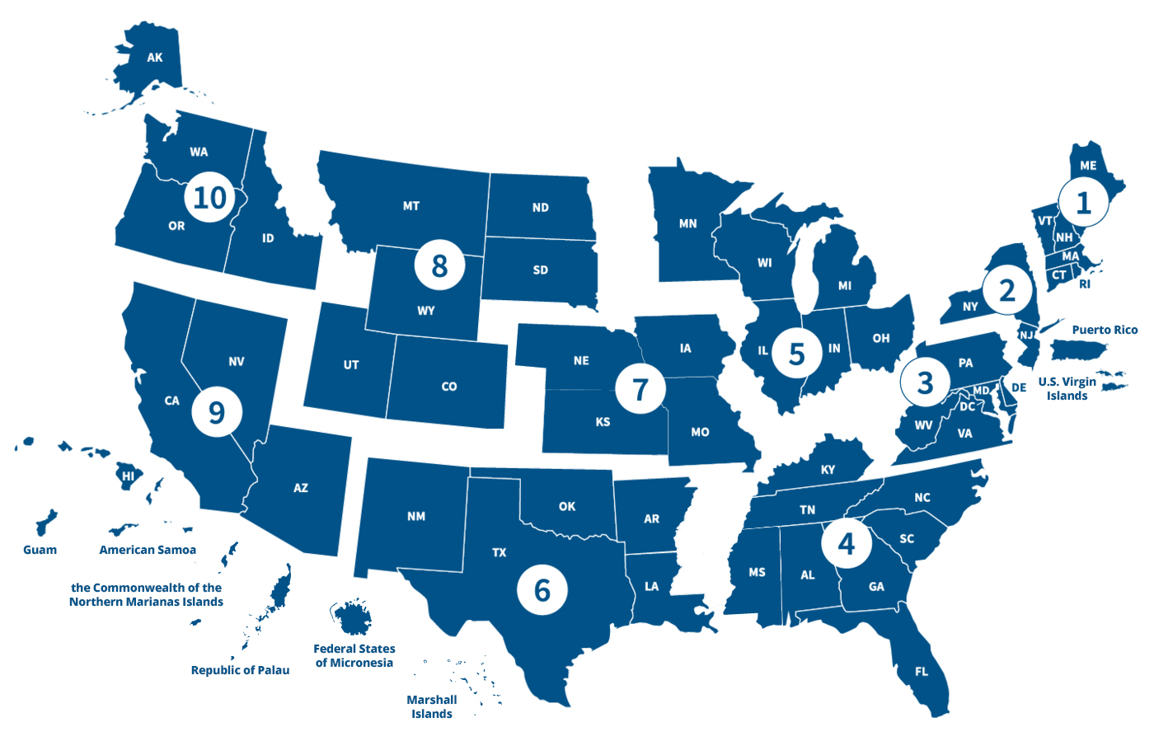
10 CDC Regional PHPR Centers
Notes:
This slide introduces the regional framework that supports public health emergency preparedness nationwide. Within each HHS region, there is a Public Health Emergency Preparedness and Response Center—or PHEPR Center, funded by the CDC.

Slide 4
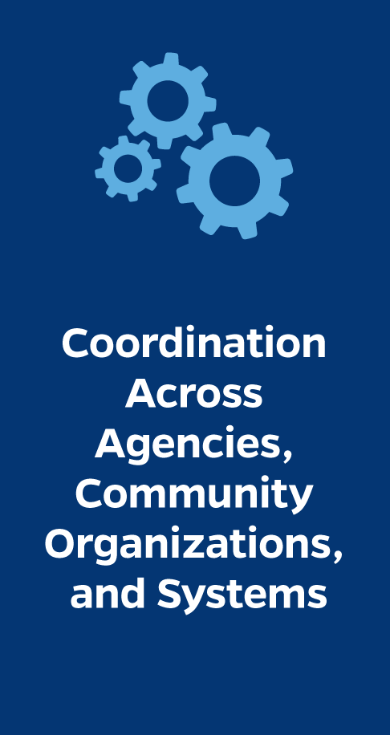
Network mapping
When a public health event becomes a state-level emergency, departments/ agencies need to share information and coordinate their response.
Having previously identified effective chains of communication and coordination can save time, resources, and lives.
Public health events that involve the entirety of a Region may be rare; however, there are times when 2-3 states need to coordinate. Having regional stakeholders identified and networked is essential.
Notes:
Network mapping is a method that helps us understand how organizations, agencies, and partners are connected—who shares information with whom, where coordination is strong, and where gaps may exist.

Slide 5
Coordination across agencies, community organizations, and systems
Intervention: Develop and use network maps to improve intra- and inter-state communication and coordination during public health emergencies in a Region
Goal: Improve departmental information sharing and increase coordination through: enhanced understanding of state and regional partner roles and responsibilities during a public health emergency; established operational parameters; and improved networks and operational plans
Notes:
This slide outlines both the intervention and the goal of this work.
The intervention is the development and use of network maps to improve both intra-state and inter-state communication and coordination during public health emergencies across Region 3.
In practical terms, this means taking what can often feel like an informal or relationship-based understanding of coordination and making it visible, structured, and actionable. The maps help show how agencies and partners are connected, where information flows, and where coordination may need to be strengthened.
The overarching goal is to improve departmental information sharing and increase coordination during a public health emergency

Slide 6
The Mapping Process
Extended PHEPR function identification
Plan review and inventory
Scenario-based mapping
Role alignment
Event specific network design
Map integration
Iterative validation
Stakeholder mapping
Notes:
This slide walks through the process used to develop the network maps, moving from initial partner engagement through operational integration.

Slide 7
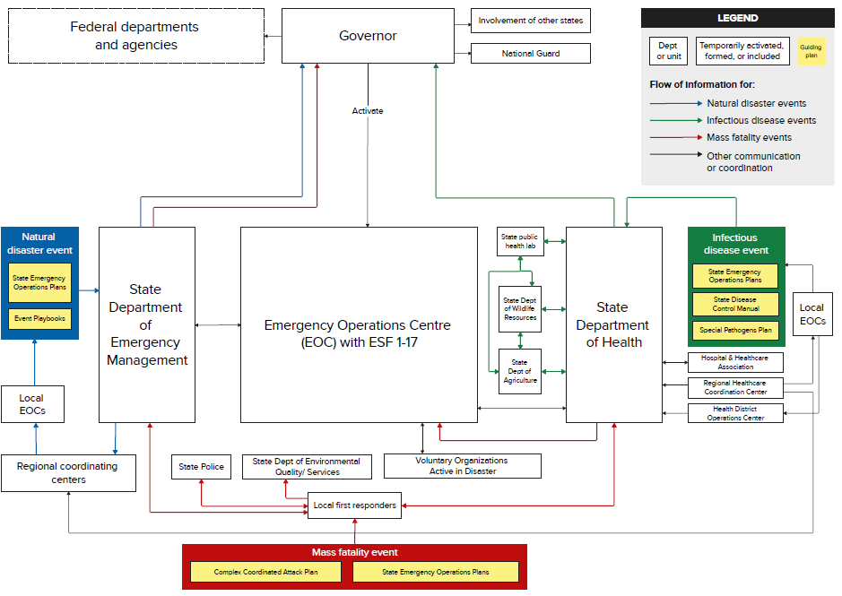
Map 1: event-specific PHPR network map
Notes:
This slide shows a generic example of an “extended PHPR function” network map. Though there is a lot going on visually, the purpose of this map is not to absorb every connection on first glance. Instead, the goal is to visually depict and demystify who does what during a public health emergency.

Slide 8
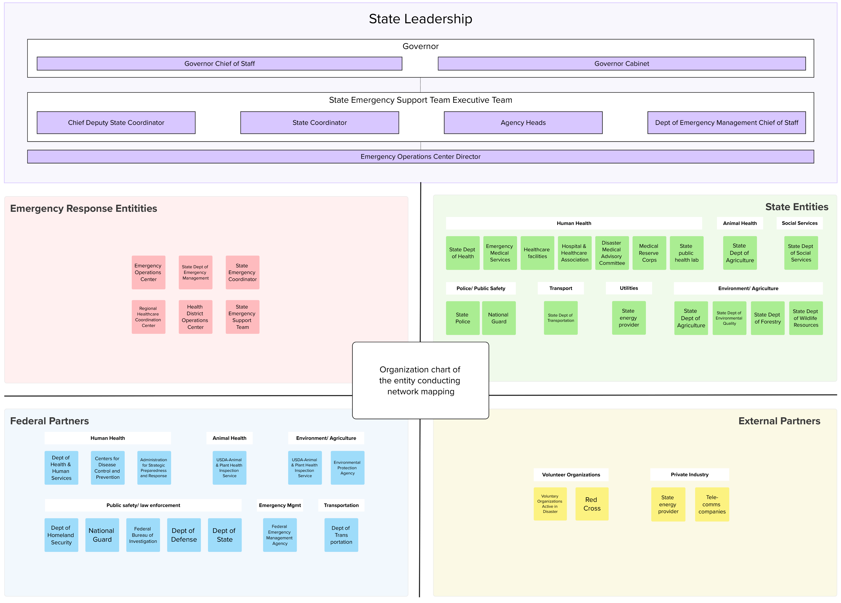
Map 2: partners involved in PHPR
Notes:
This slide shows an example stakeholder network map, which complements the extended function map by focusing on who is involved, rather than how specific functions are carried out.

Slide 9
How to use these network maps
Clearly identify chains of command for all-hazard and scenario-specific PHPR, allowing for strengthening of relevant PHPR plans or operations
Use them with teams and partners as a visual tool to build a shared understanding of what coordination looks like during emergencies
Identify priorities for building and strengthening partnerships with entities featured in these networks for operational efficiency
Utilize as a baseline, living document to track future changes in partner landscape and coordination processes
Notes:
This final slide focuses on how these network maps are intended to be used in practice.

